Slide 1
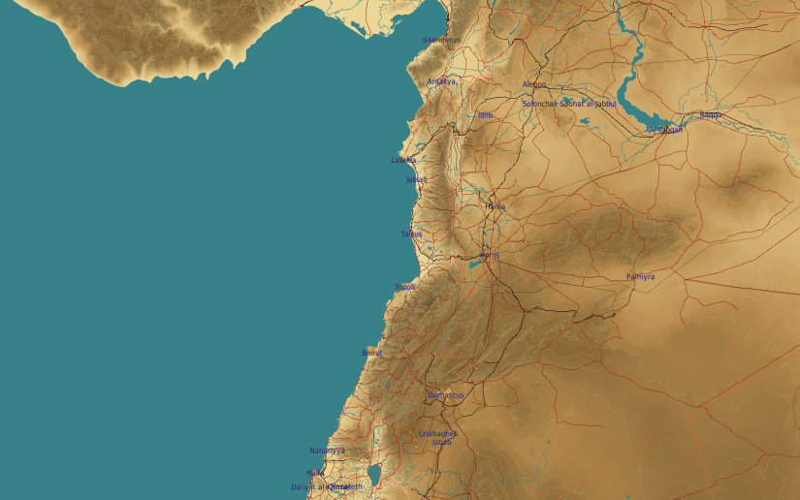
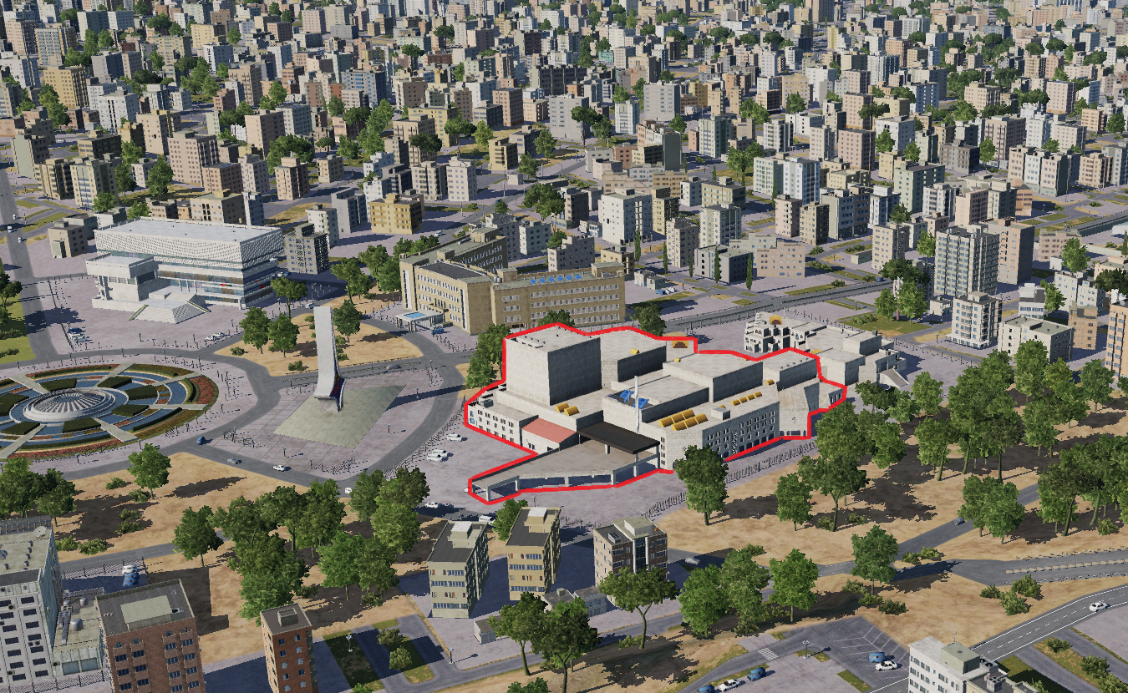
OPARTGT035 International communication center
N
Assembly Plant
35
DESCRIPTION OF THE DESIRED POINTS OF IMPACT WITH WPN TYPE:
OPARTGT035 – Communications Centre
DPI 1 N33 30.742 E036 16.697 /2260ft/(500Ibs bomb – multiple required spread across the structure)
4
5
6
Residential and civilian infrastructure surround the communications centre.
7
8

